Slide 1


Slide 2
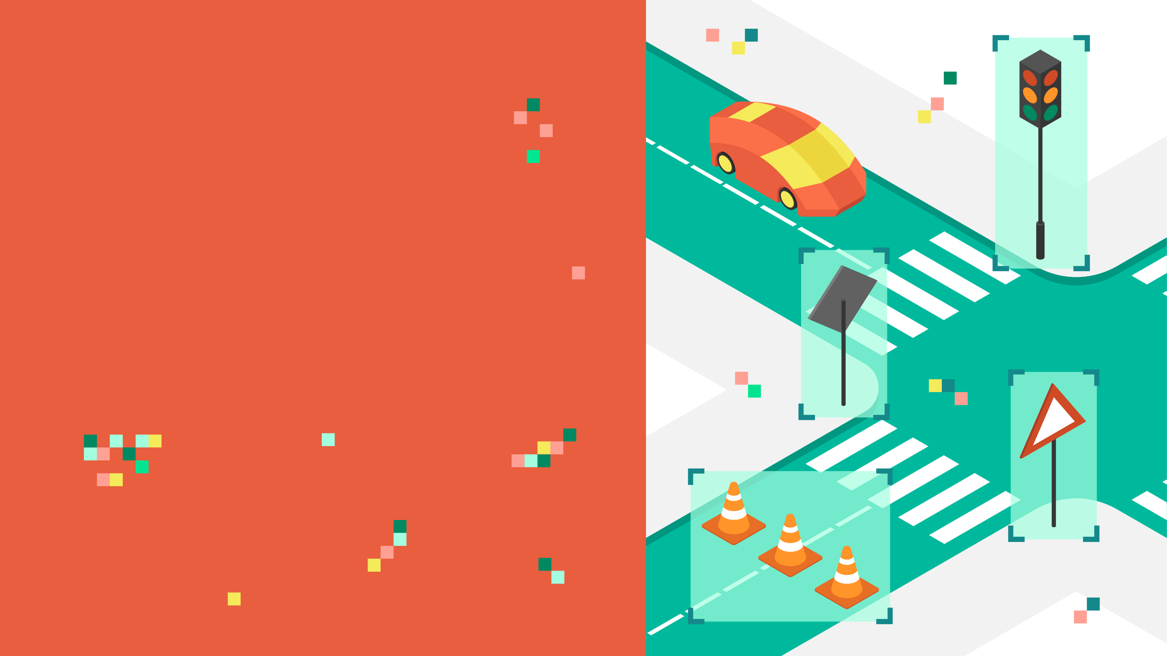
LE-NET DEEP
NETWORK
TRAFFIC SIGN
CLASSIFICATION

Slide 3
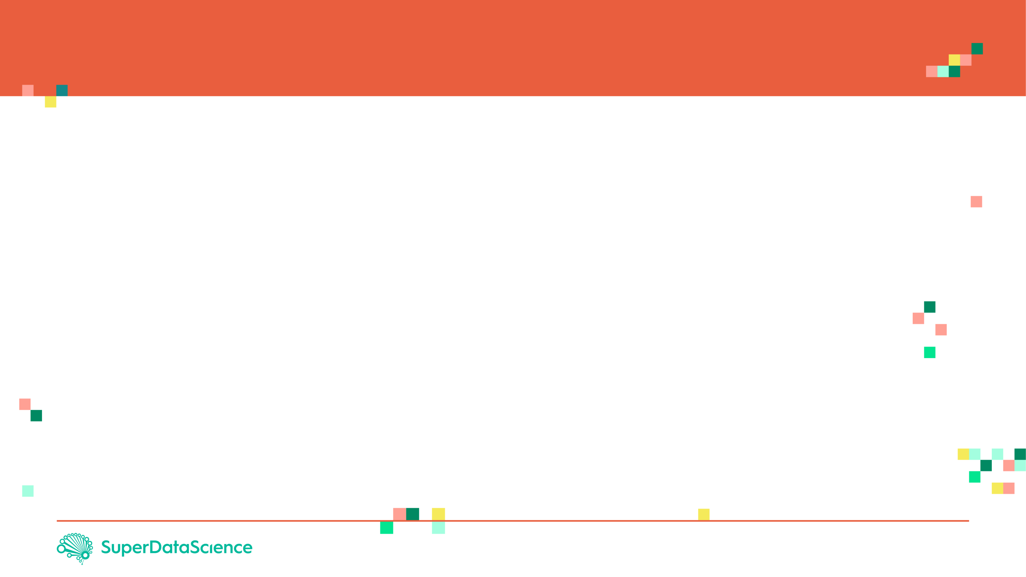
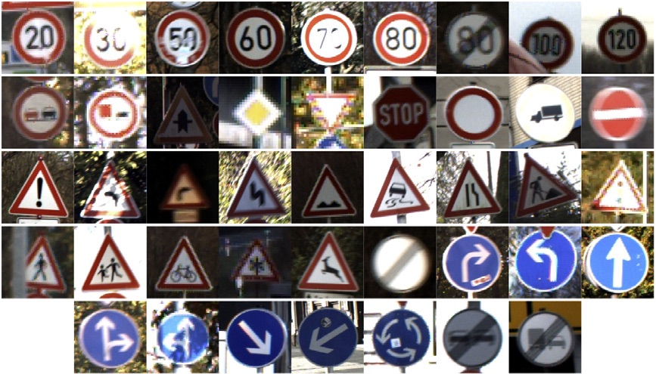
PROJECT OVERVIEW
Traffic sign classification is an important task for self driving cars.
In this project, a Deep Network known as LeNet will be used for traffic sign images classification.
The dataset contains 43 different classes of images.
Classes are as listed below:
( 0, b'Speed limit (20km/h)') ( 1, b'Speed limit (30km/h)') ( 2, b'Speed limit (50km/h)') ( 3, b'Speed limit (60km/h)') ( 4, b'Speed limit (70km/h)')
( 5, b'Speed limit (80km/h)') ( 6, b'End of speed limit (80km/h)') ( 7, b'Speed limit (100km/h)') ( 8, b'Speed limit (120km/h)') ( 9, b'No passing')
(10, b'No passing for vehicles over 3.5 metric tons') (11, b'Right-of-way at the next intersection') (12, b'Priority road') (13, b'Yield') (14, b'Stop')
(15, b'No vehicles') (16, b'Vehicles over 3.5 metric tons prohibited') (17, b'No entry')
(18, b'General caution') (19, b'Dangerous curve to the left')
(20, b'Dangerous curve to the right') (21, b'Double curve')
(22, b'Bumpy road') (23, b'Slippery road')
(24, b'Road narrows on the right') (25, b'Road work')
(26, b'Traffic signals') (27, b'Pedestrians') (28, b'Children crossing')
(29, b'Bicycles crossing') (30, b'Beware of ice/snow')
(31, b'Wild animals crossing')
(32, b'End of all speed and passing limits') (33, b'Turn right ahead')
(34, b'Turn left ahead') (35, b'Ahead only') (36, b'Go straight or right')
(37, b'Go straight or left') (38, b'Keep right') (39, b'Keep left')
(40, b'Roundabout mandatory') (41, b'End of no passing')
(42, b'End of no passing by vehicles over 3.5 metric tons')

Slide 4

PROJECT OVERVIEW
The dataset consists of 43 different classes.
Images are 32 x 32 pixels
INPUT IMAGE
TARGET CLASSES
20km/h
50 km/h
100 km/h
Stop
Yield
CLASSIFIER
32
32

Slide 5
LENET NETWORK

Slide 6
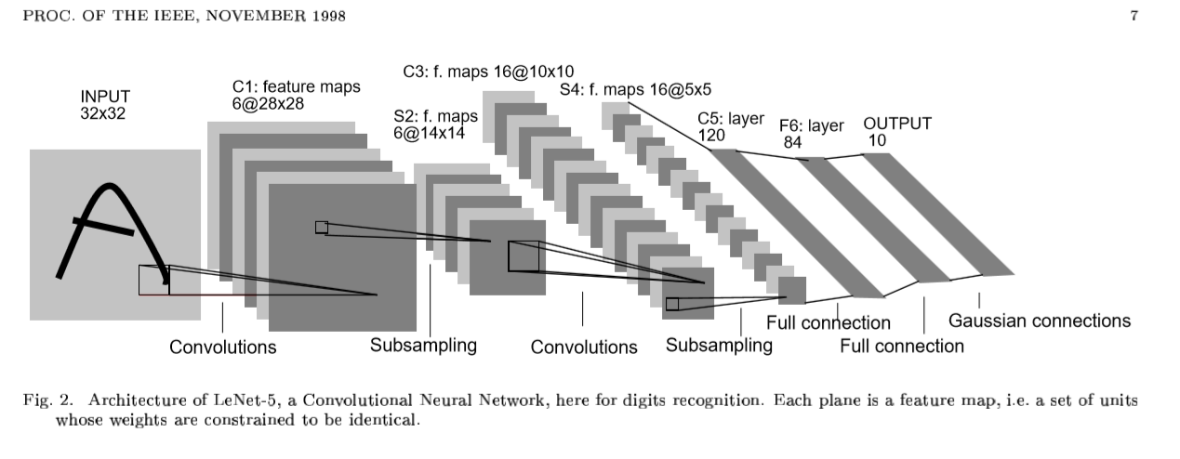
LENET ARCHITECURE
The network used is called LeNet that was presented by Yann LeCun
Reference and photo credit: http://yann.lecun.com/exdb/publis/pdf/lecun-01a.pdf
C: Convolution layer, S: subsampling layer, F: Fully Connected layer

Slide 7
LENET LAYERS
STEP 1: THE FIRST CONVOLUTIONAL LAYER #1
Input = 32x32x1
Output = 28x28x6
Output = (Input-filter+1)/Stride* => (32-5+1)/1=28
Used a 5x5 Filter with input depth of 3 and output depth of 6
Apply a RELU Activation function to the output
pooling for input, Input = 28x28x6 and Output = 14x14x6
STEP 2: THE SECOND CONVOLUTIONAL LAYER #2
Input = 14x14x6
Output = 10x10x16
Layer 2: Convolutional layer with Output = 10x10x16
Output = (Input-filter+1)/strides => 10 = 14-5+1/1
Apply a RELU Activation function to the output
Pooling with Input = 10x10x16 and Output = 5x5x16
STEP 3: FLATTENING THE NETWORK
Flatten the network with Input = 5x5x16 and Output = 400
STEP 4: FULLY CONNECTED LAYER
Layer 3: Fully Connected layer with Input = 400 and Output = 120
Apply a RELU Activation function to the output
STEP 5: ANOTHER FULLY CONNECTED LAYER
Layer 4: Fully Connected Layer with Input = 120 and Output = 84
Apply a RELU Activation function to the output
STEP 6: FULLY CONNECTED LAYER
Layer 5: Fully Connected layer with Input = 84 and Output = 43
* Stride is the amount by which the kernel is shifted when the kernel is passed over the image.
Reference and phot credit: http://yann.lecun.com/exdb/publis/pdf/lecun-01a.pdf

Slide 8
WHAT ARE CNNs AND HOW DO THEY LEARN? (REVIEW)

Slide 9

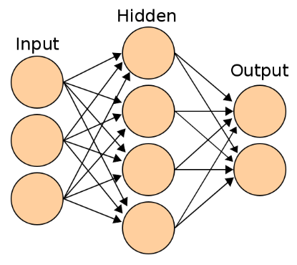
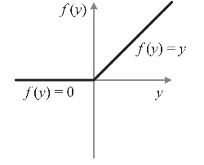
CONVOLUTIONAL NEURAL NETWORKS: ENTIRE NETWORK OVERVIEW
TARGET CLASSES
Stop
Yield
30 km/h
50 km/h
CONVOLUTION
POOLING
FLATTENING
KERNELS/
FEATURE DETECTORS
POOLING FILTERS
CONVOLUTIONAL LAYER
POOLING LAYER (DOWNSAMPLING)
Photo Credit: https://commons.wikimedia.org/wiki/File:Artificial_neural_network.svg

Slide 10
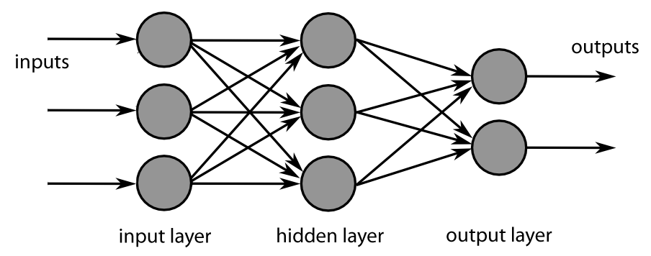
INCREASE FILTERS/DROPOUT
Improve accuracy by adding more feature detectors/filters or adding a dropout.
Dropout refers to dropping out units in a neural network.
Neurons develop co-dependency amongst each other during training
Dropout is a regularization technique for reducing overfitting in neural networks.
It enables training to occur on several architectures of the neural network
KERNELS/
FEATURE DETECTORS
64 INSTEAD OF 32
Photo Credit: https://fr.m.wikipedia.org/wiki/Fichier:MultiLayerNeuralNetworkBigger_english.png

Slide 11
CONFUSION MATRIX
TRUE CLASS
+
-
TYPE I ERROR
+
TRUE +
FALSE +
PREDICTIONS
FALSE -
TRUE -
-
TYPE II ERROR

Slide 12
CONFUSION MATRIX
A confusion matrix is used to describe the performance of a classiﬁcation model:
True positives (TP): cases when classiﬁer predicted TRUE (they have the disease), and correct class was TRUE (patient has disease).
True negatives (TN): cases when model predicted FALSE (no disease), and correct class was FALSE (patient do not have disease).
False positives (FP) (Type I error): classiﬁer predicted TRUE, but correct class was FALSE (patient did not have disease).
False negatives (FN) (Type II error): classiﬁer predicted FALSE (patient do not have disease), but they actually do have the disease

Slide 13
KEY PERFORMANCE INDICATORS (KPI)
Classiﬁcation Accuracy = (TP+TN) / (TP + TN + FP + FN)
Misclassiﬁcation rate (Error Rate) = (FP + FN) / (TP + TN + FP + FN)
Precision = TP/Total TRUE Predictions = TP/ (TP+FP) (When model predicted TRUE class, how often was it right?)
Recall = TP/ Actual TRUE = TP/ (TP+FN) (when the class was actually TRUE, how often did the classiﬁer get it right?)

